Slide 1
What is Docker?
Docker is a software platform that allows you to build, deploy, and run applications quickly. Docker packages software into standardized units called containers that have everything the software needs to run including libraries, system tools, code, and runtime.
Docker is a configuration management tool that is used to automate the deployment of software in lightweight containers. These containers help applications to work efficiently in different environments.
Docker container is a software package that has all the dependencies required to run an application.
Note: A Docker Image is a template of instructions used to create containers.

Slide 2
What is a Dockerfile?
Docker Image:
A Docker Image is a read-only file with a bunch of instructions. When these instructions are executed, it creates a Docker container.
Dockerfile:
Dockerfile is a simple text file that consists of instructions to build Docker images.

Slide 3
A container is a standard unit of software that packages up code and all its dependencies so the application runs quickly and reliably from one computing environment to another.
Docker Desktop is an application that makes it easy to build, share, and run containerized applications on Mac, Linux, and Windows. It provides a graphical user interface (GUI) for managing containers, images, and volumes, as well as a command-line interface (CLI) for more advanced users.

Slide 4
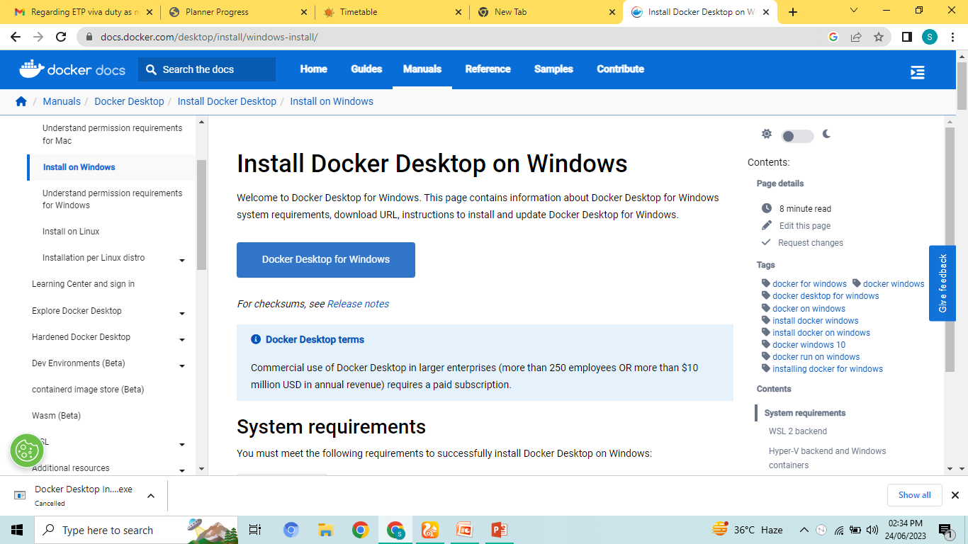
Docker Desktop
Go to Googlr chrome:-
Download: Docker Desktop Installer.exe

Slide 5
Thinks to be noted
System’s compatibility
Docker Desktop runs on windows version 10 or above 10.
Virtualization is enabled.
Virtualization is enabled by rebooting your system.

Slide 6
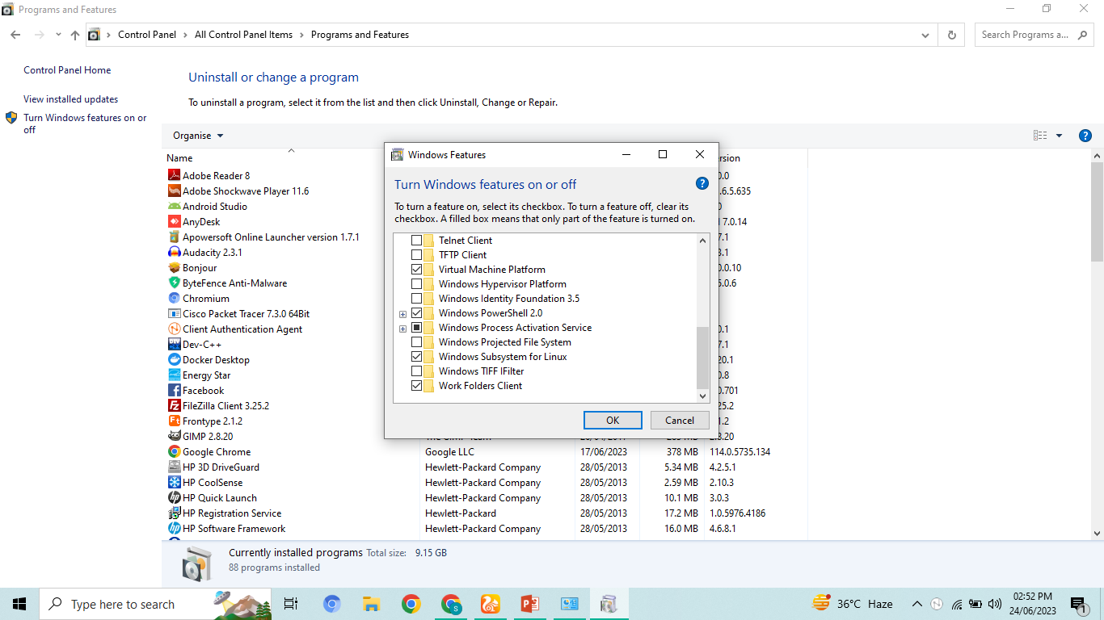
Docker Steps on Windows:
Open Control Panel.
Open Programs and Features.
Click on Turn Windows features on or off.
Select windows sub system for Linux
At last click on restart system.

Slide 7
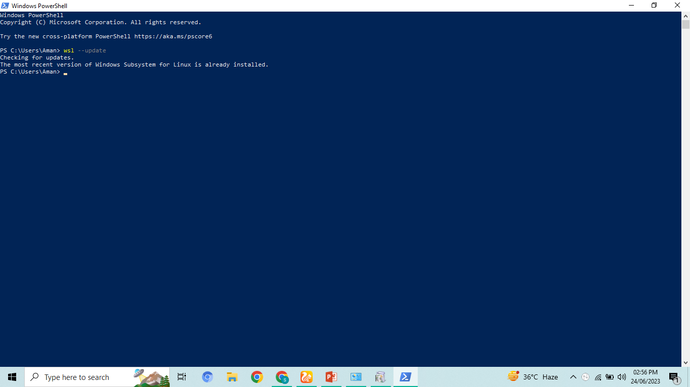
Continue:
Go to windows Power Shell and type
wsl --update

Slide 8
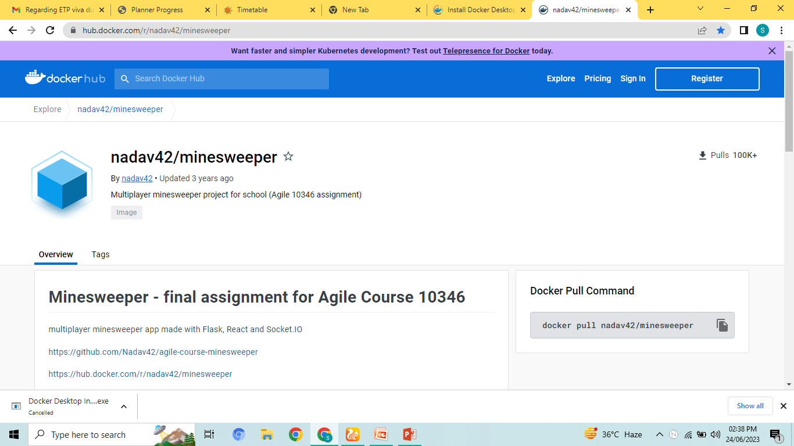
Working with Docker Containers:
Search from Google Chrome:
HUB.docker.com/r/nadav42/minesweeper

Slide 9
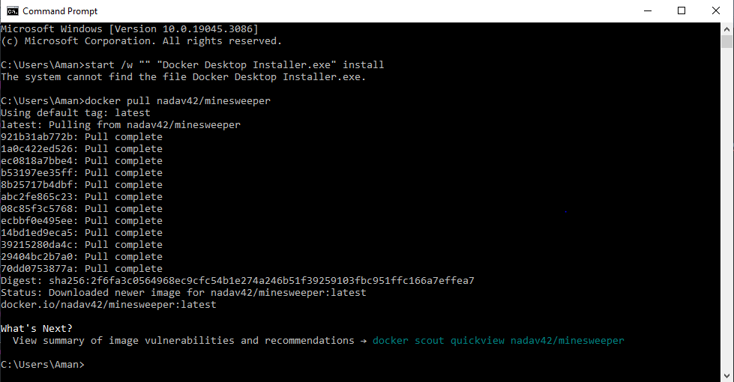
Docker Pull Command
Copy “docker pull nadav42/minesweeper” from Docker Hub and paste it on command prompt.

Slide 10
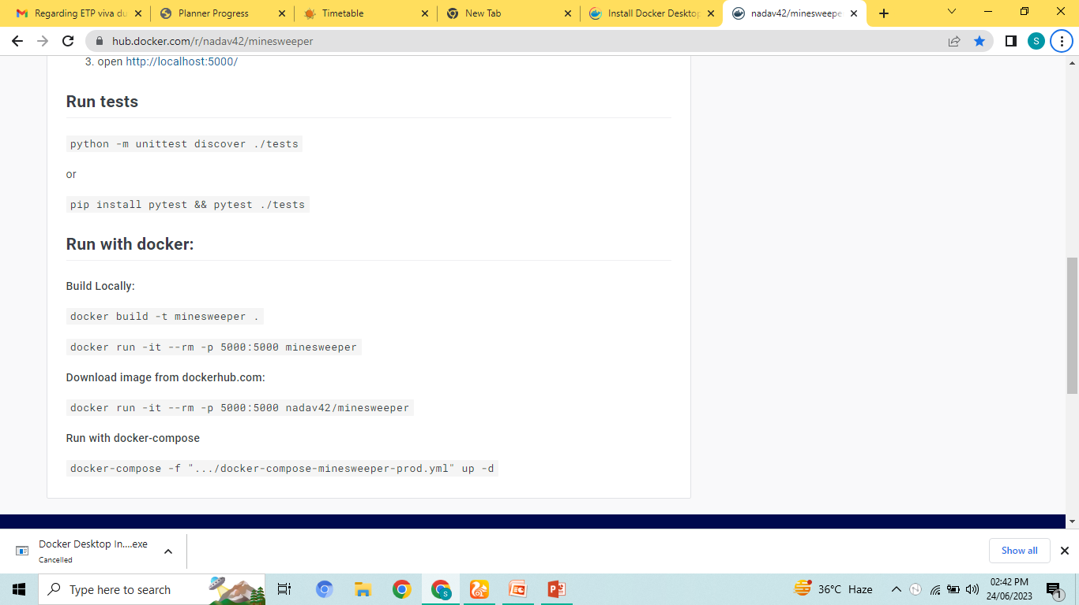
Continue:
Then go to Run with Docker and copied the below mentioned commands.
Build Locally:
docker build -t minesweeper .
Download image from dockerhub.com:
docker run -it --rm -p 5000:5000 nadav42/minesweeper

Slide 11
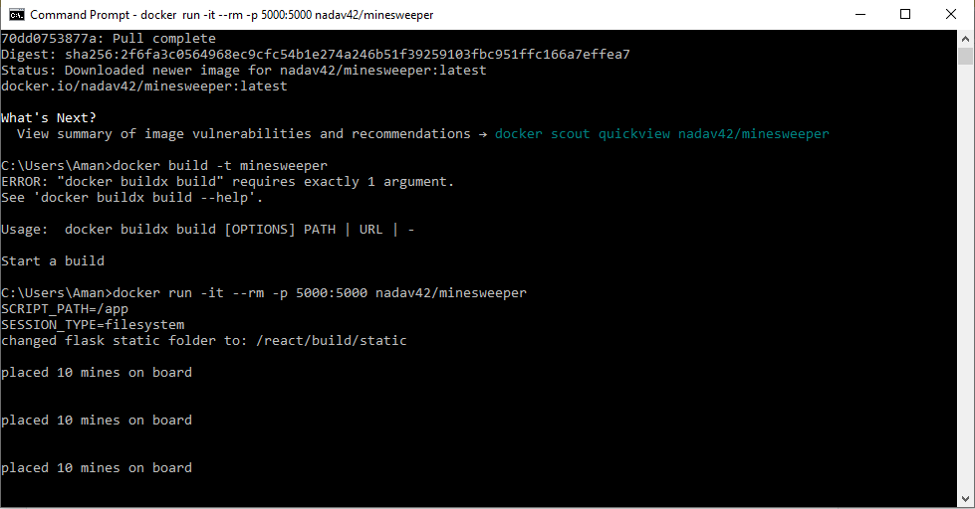
Continue :
Paste these commands on command prompt
After running build and download Docker image.

Slide 12
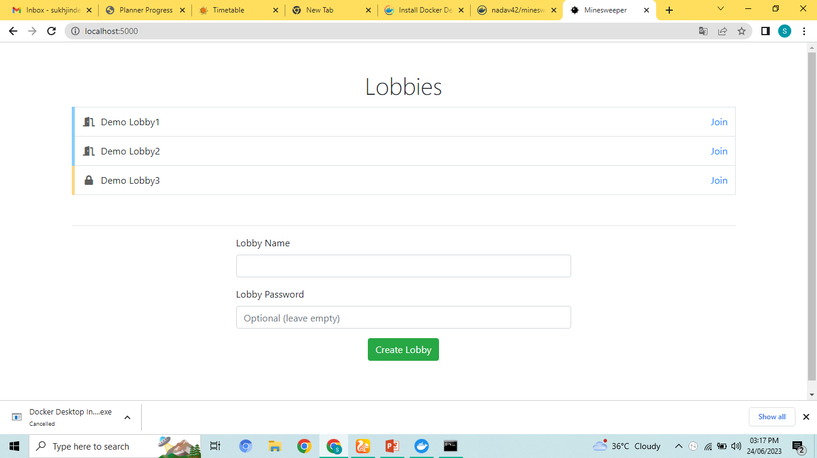
Results:
Go to chrome and then type
Localhost:5000 in search bar.

Slide 13
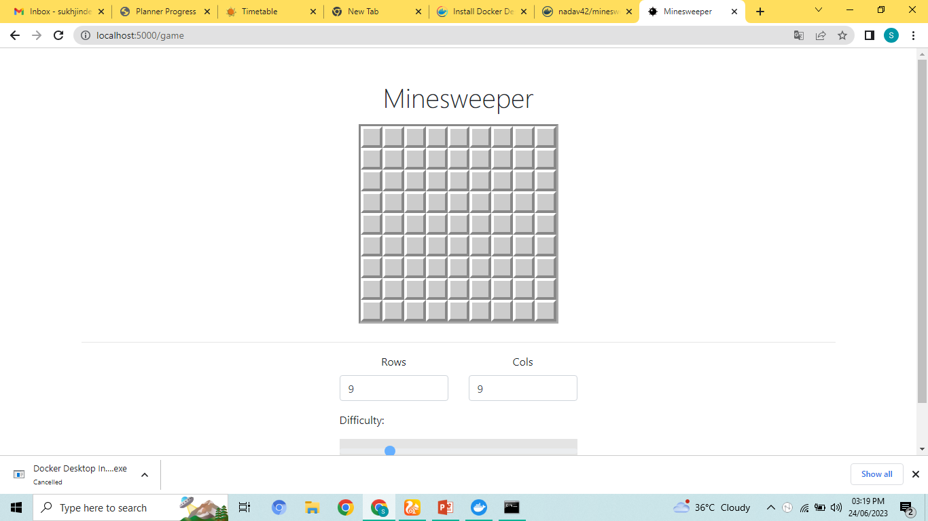
Result of Minesweeper game on localhost:

Slide 14
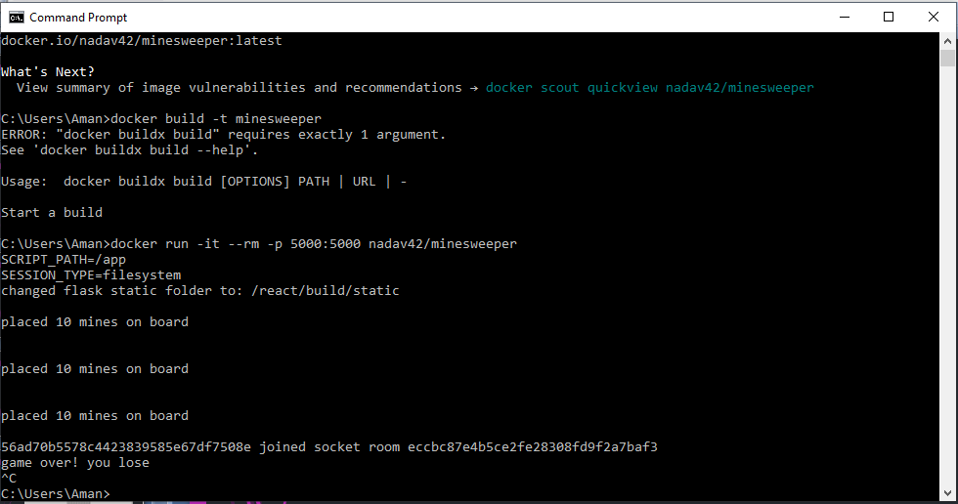
Stop the game:
Type ctrl+c on command prompt.

Slide 15
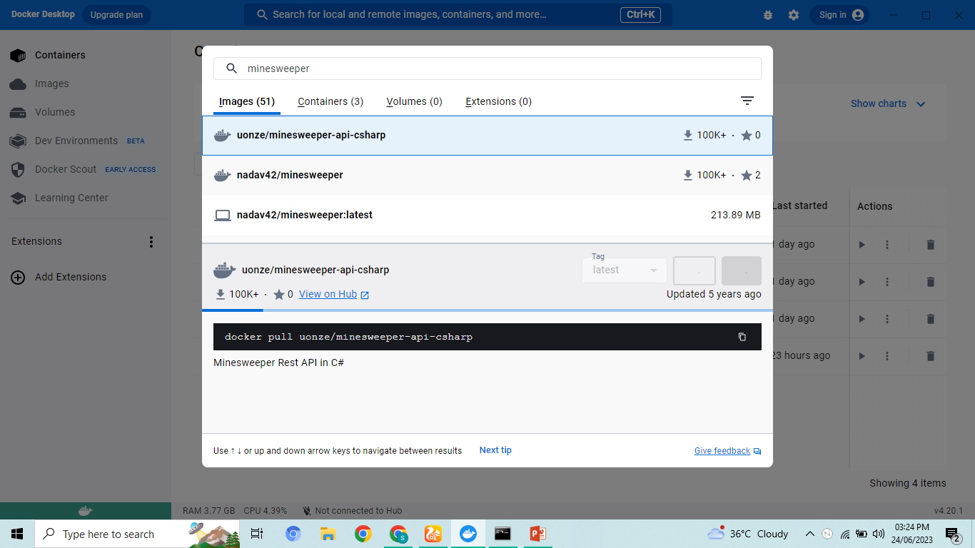
Working on Docker Desktop:
Search on Docker’s Desktop: Minessweeper.

Slide 16
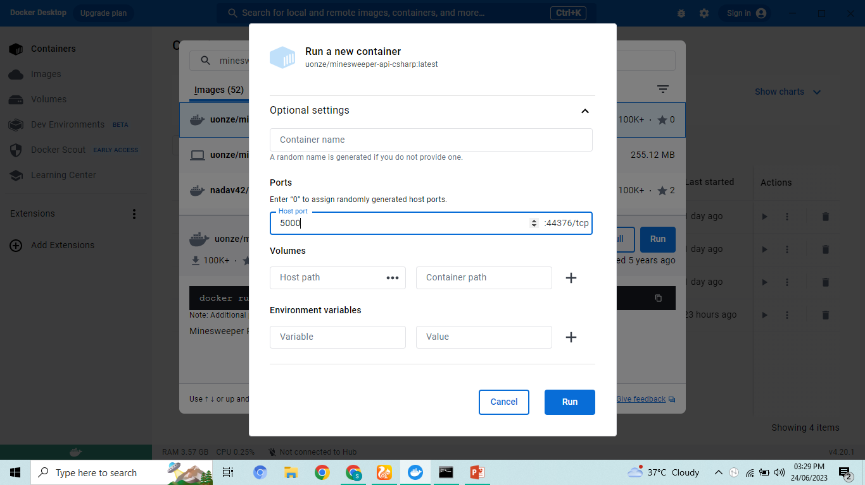
Continue:
Click on Run and in optional settings, type host port i.e. 5000.

Slide 17
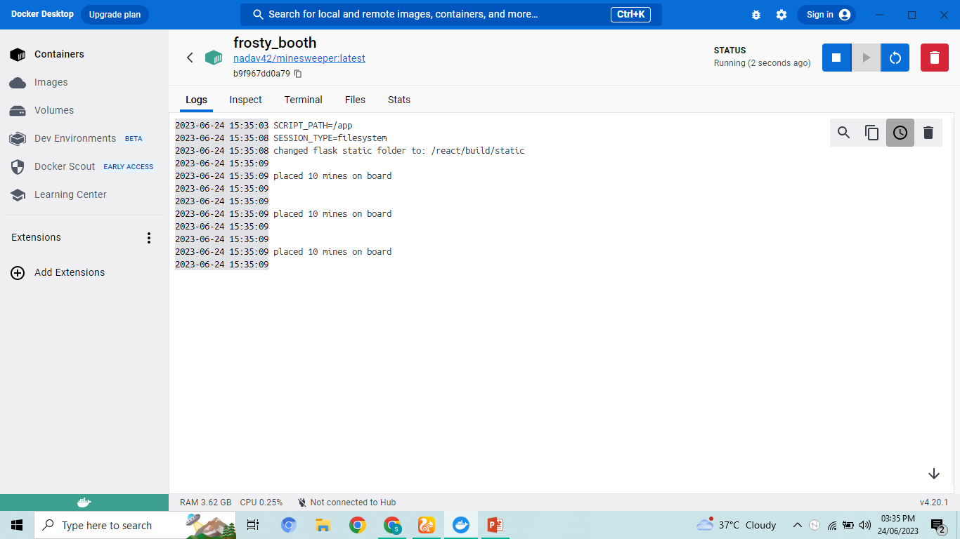
Results:
Shown on Docker Desktop.

Slide 18
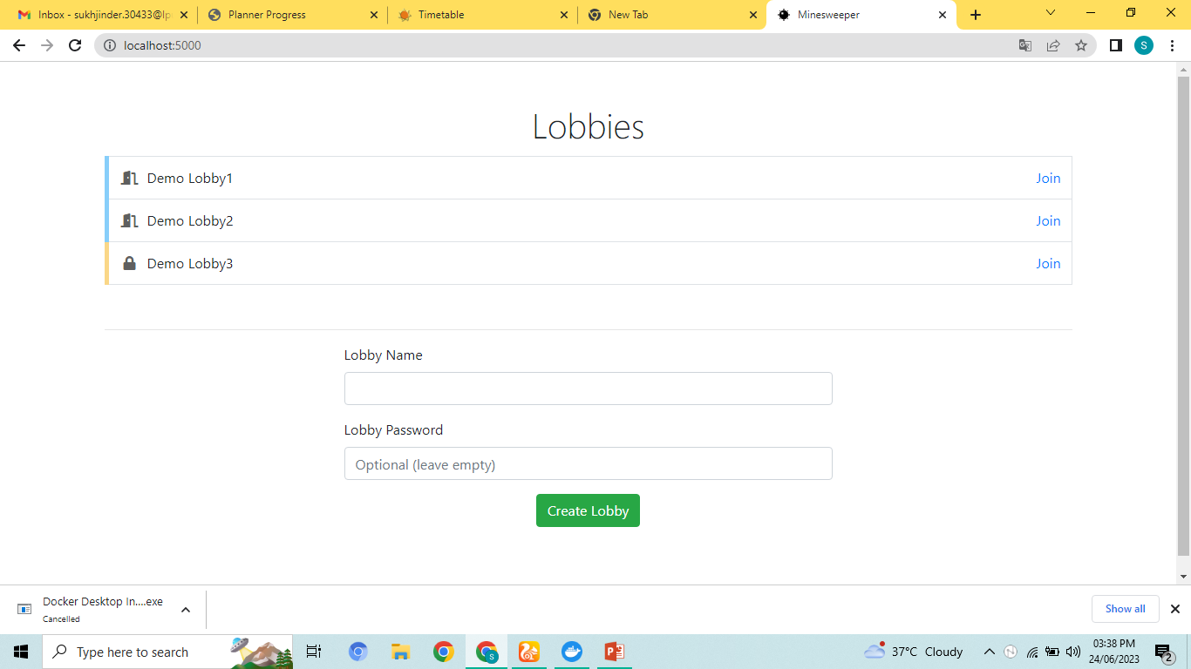
Result of Minesweeper game
on localhost:5000

Slide 19
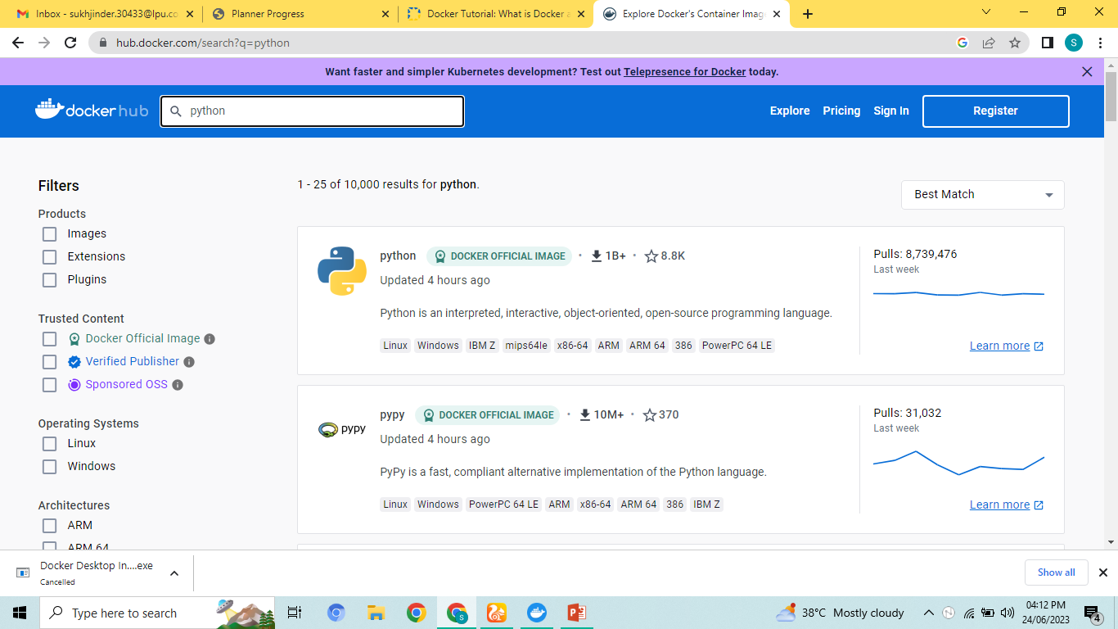
Docker Hub:
Go to docker hub official site and search for Python Image.

Slide 20
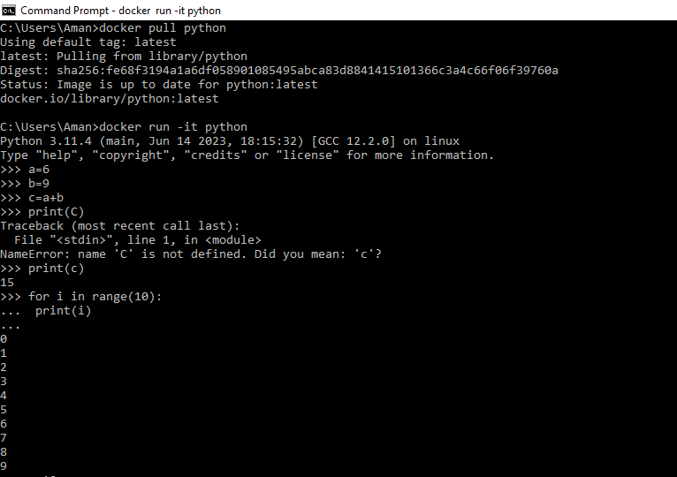
Continue:
Copy the command “docker pull python” and docker run –it python from docker hub and run it on command prompt.

Slide 21
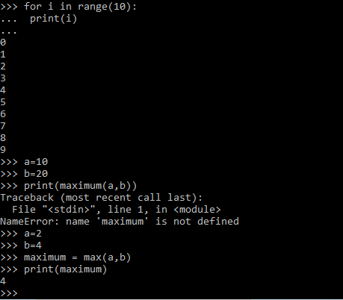

Slide 22
CloudSim
CloudSim is a simulation toolkit that supports the modelling and simulation of the core functionality of the cloud, like job/task queue, processing of events, creation of cloud entities (datacenter, datacenter brokers, etc), communication between different entities, implementation of broker policies, etc.
This simulation toolkit is an API that allows a developer to run any server hardware model as a software simulation, to analyse its behaviour for real-world workloads. Therefore, it is clear that it allows a researcher to simulate the Infrastructure as a Service (IaaS) layer.

Slide 23
This includes software models of data centers, hosts, storage, virtual machines, Cloud datacentre brokers, allocation & scheduling policies for the virtual machines as well as tasks, power management policies including migrations and consolidation of the virtual machines over different hosts, defining the workload attributes for its execution simulation over the cloud systems, etc.
Specification required: The cloudsim is a software simulation toolkit and is developed using Java programming language, Therefore, any computer system with a dual-core processor, 2 GB RAM, and 1 GB storage is good enough to simulate the cloud-based systems using the cloudsim as this is required to support the JRE working.

Slide 24
How to download Cloudsim?
Cloudsim project source code, as well as compiled jars files, are published through the GitHub project page: https://github.com/Cloudslab/cloudsim.
Files used :
https://drive.google.com/file/d/1p_mEGiTeCCTv3l83cKPKY-h3PZh7DfhD/view?pli=1
Softwares used:- Eclipse 2022-12 :
https://www.eclipse.org/downloads/

Slide 25
Cloud Bus links nodes of a distributed system with a lightweight message broker. This can then be used to broadcast state changes (e.g. configuration changes) or other management instructions. AMQP and Kafka broker implementations are included with the project.
A cloudlet is a small-scale data center or cluster of computers designed to quickly provide cloud computing services to mobile devices, such as smartphones, tablets and wearable devices, within close geographical proximity.
Cloud Broker is an entity that manages the use, performance, and delivery of cloud services and negotiates relationships between Cloud Providers and Cloud Consumers.

Slide 26
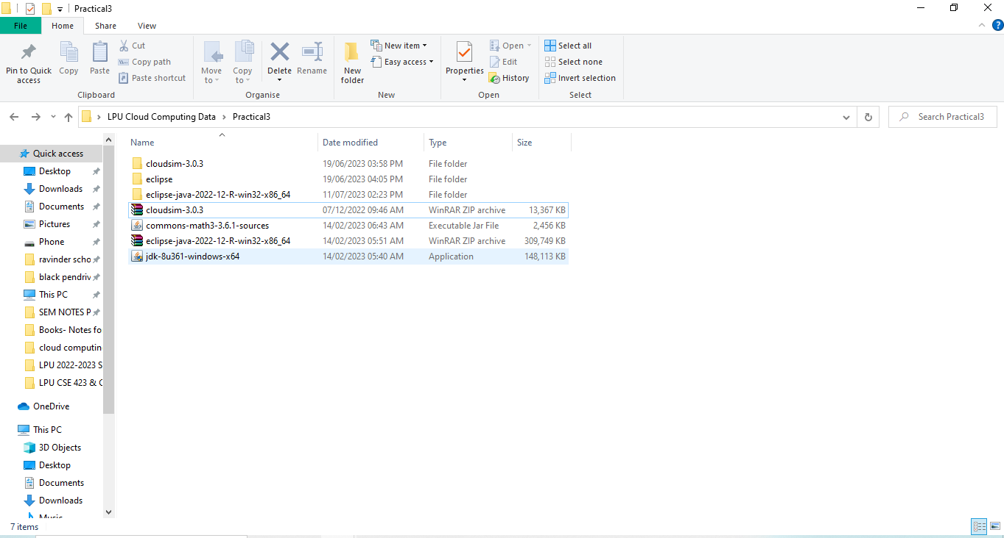
CloudSim
Extract CloudSim 3.0.3
Install Eclipse IDE
Install JDK

Slide 27
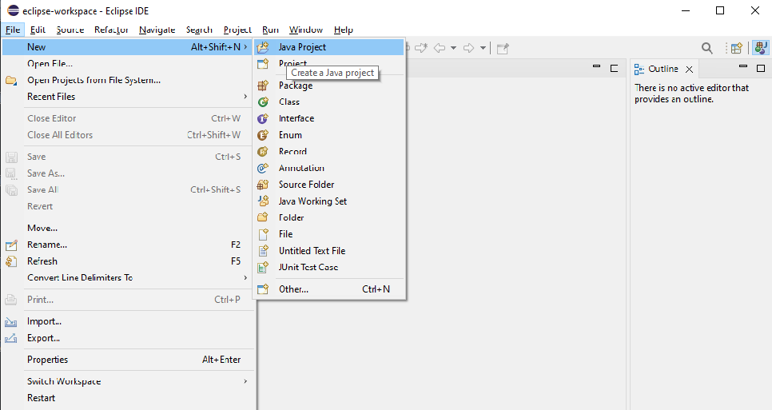
Launch Cloudsim
Open Eclipse IDE
File
New
Java Project

Slide 28
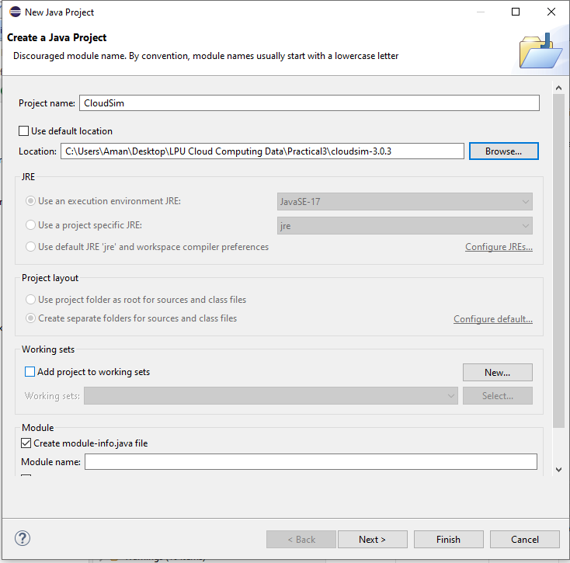
Continue:
4. Project Name: Cloudsim
Use Default Location (choose untick )
5. Go to browse and add CloudSim 3.0.3
6. Next

Slide 29
Continue
7. Libraries
8. Add External Jars
9. Select Common maths
10. Finish

Slide 30
Cloudsim examples :
Example 1:
A simple example showing how to create a datacenter with one host and run one cloudlet on it.
Example 2:
A simple example showing how to create a datacenter with one host and run two cloudlets on it. The cloudlets run in VMs with the same MIPS equirements. * The cloudlets will take the same time to complete the execution.
2VMs, in same dc, at same host
Example 3:
A simple example showing how to create a datacenter with two hosts and run two cloudlets on it. The cloudlets run in * VMs with different MIPS requirements. The cloudlets will take different time to complete the execution depending on the requested VM performance.
2vms on dc0, but both at diff host, cloudlet=2,

Slide 31
Example 4.
A simple example showing how to create two datacenters with one host each and run two cloudlets on them.
Example 5.
A simple example showing how to create two datacenters with one host each and run cloudlets of two users on them.
Example 6.
* An example showing how to create scalable simulations.
Example 7. An example showing how to pause and resume the simulation, and create simulation entities (a DatacenterBroker in this example) dynamically.
Example 8. An example showing how to create simulation entities (a DatacenterBroker in this example) in run-time using
* a globar manager entity (GlobalBroker).

